Slide 1

Startup Weekend Aix-Marseille
October, 28-31th, 2016

Slide 2
Lore ipsum…

Slide 3
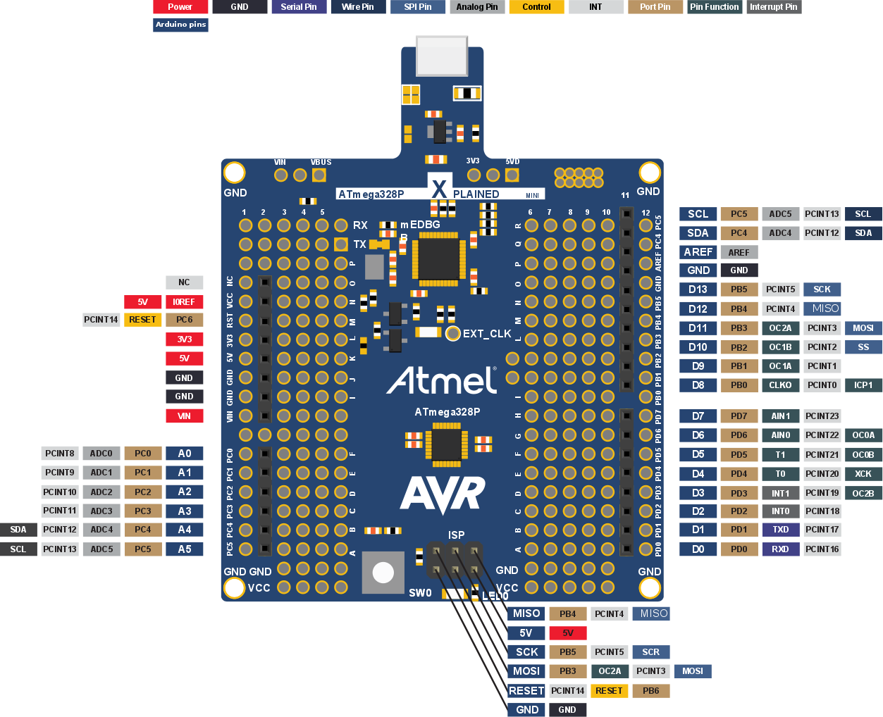
AVR atmega328p Xplained mini
Arduino pinout view

Slide 4
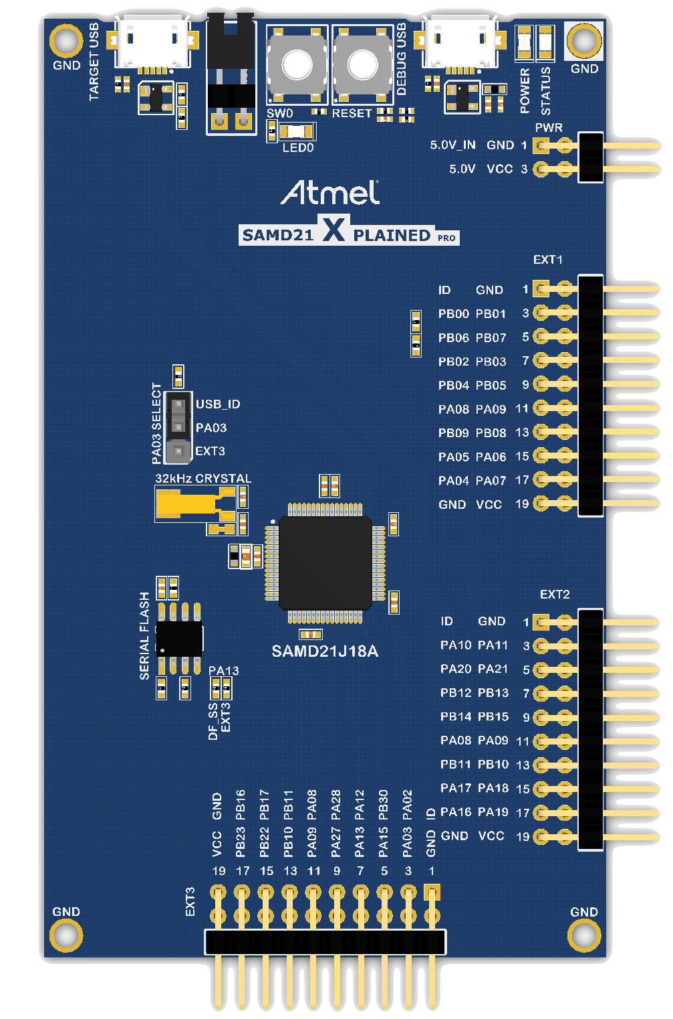
SAMD21 Xplained Pro
Arduino pinout view

Slide 5
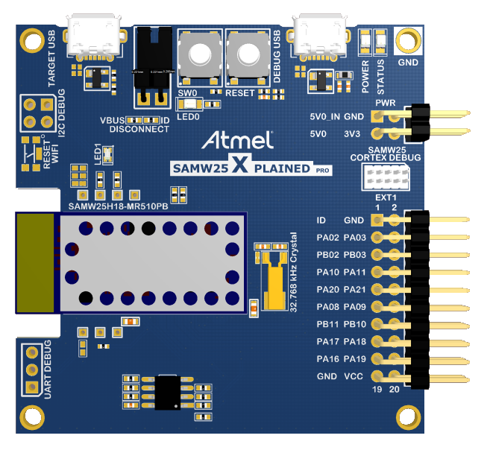
SAMW25 Xplained Pro
Arduino pinout view

Slide 6
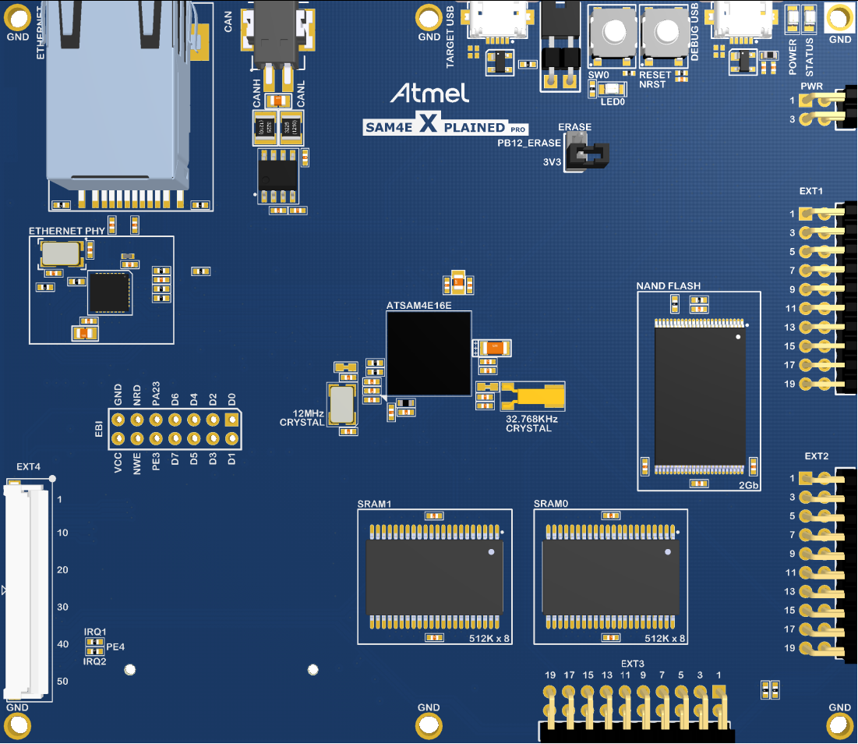

SAM4E Xplained Pro
Atmel Studio/Software Framework pinout

Slide 7
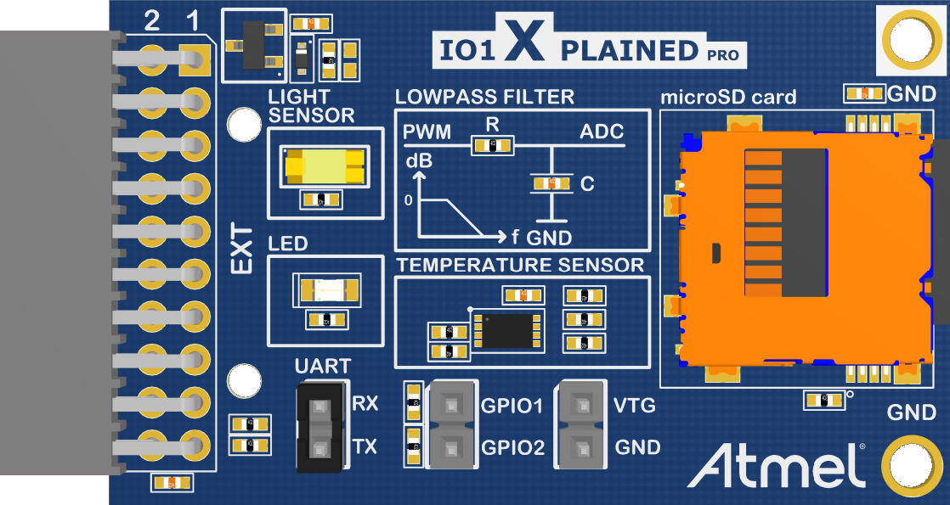
IO1 Xplained Pro
Extension pinout

Slide 8
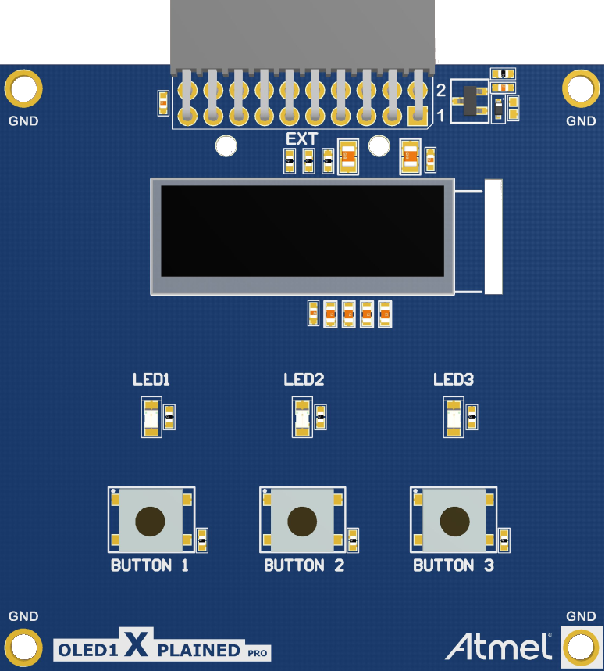
OLED1 Xplained Pro
Extension pinout

Slide 9
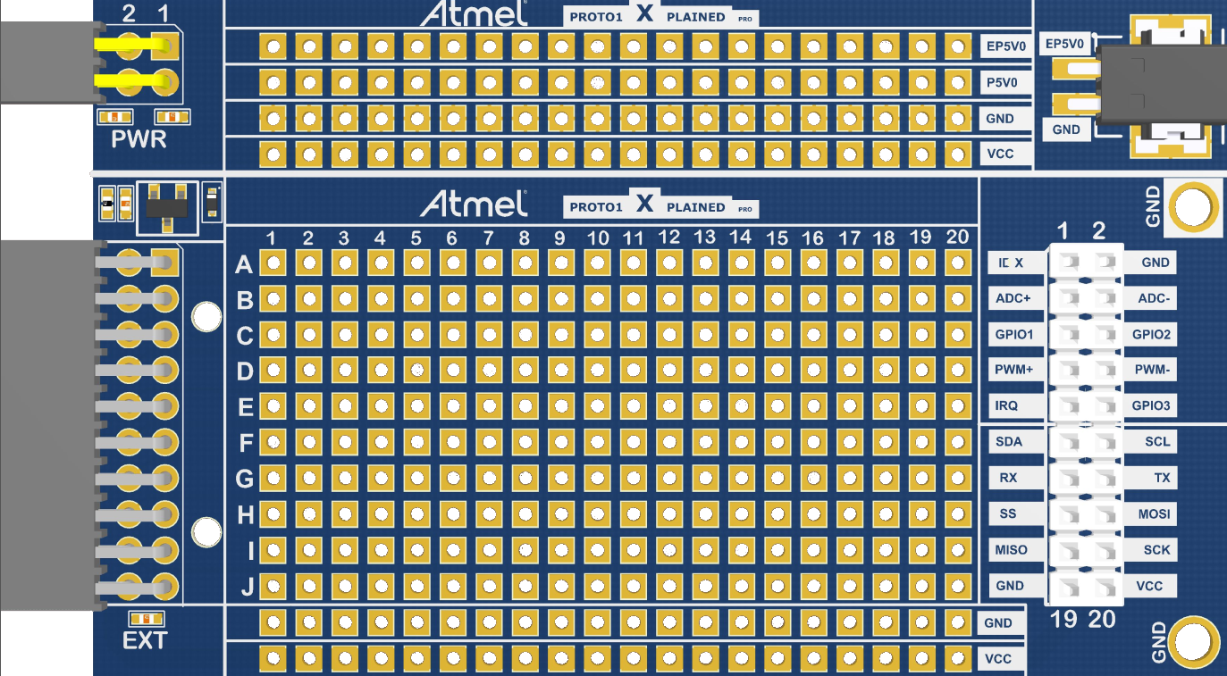
PROTO1 Xplained Pro
Extension pinout

Slide 10
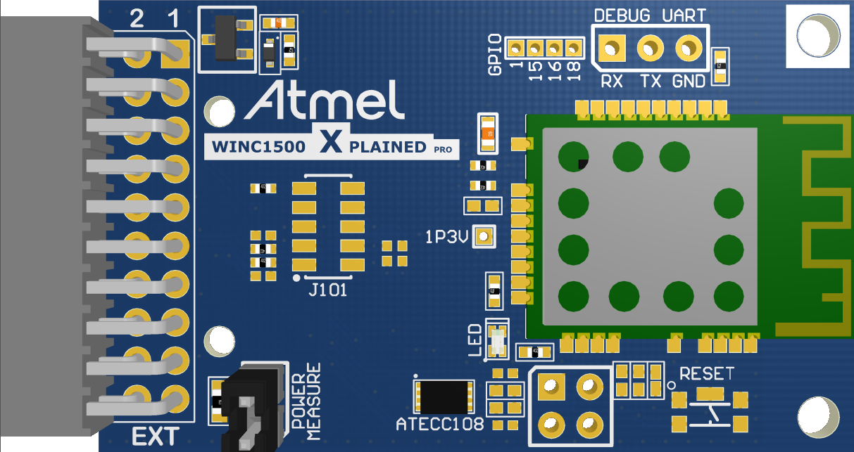
WINC1500 Xplained Pro
Extension pinout

Slide 11








© 2016 Atmel Corporation.
Atmel®, Atmel logo and combinations thereof, Enabling Unlimited Possibilities®, and others are registered trademarks or trademarks of Atmel Corporation or its subsidiaries. ARM®, ARM Connected® logo and others are the registered trademarks or trademarks of ARM Ltd. Other terms and product names may be the trademarks of others.
Disclaimer: The information in this document is provided in connection with Atmel products. No license, express or implied, by estoppel or otherwise, to any intellectual property right is granted by this document or in connection with the sale of Atmel products. EXCEPT AS SET FORTH IN THE ATMEL TERMS AND CONDITIONS OF SALES LOCATED ON THE ATMEL WEBSITE, ATMEL ASSUMES NO LIABILITY WHATSOEVER AND DISCLAIMS ANY EXPRESS, IMPLIED OR STATUTORY WARRANTY RELATING TO ITS PRODUCTS INCLUDING, BUT NOT LIMITED TO, THE IMPLIED WARRANTY OF MERCHANTABILITY, FITNESS FOR A PARTICULAR PURPOSE, OR NON-INFRINGEMENT. IN NO EVENT SHALL ATMEL BE LIABLE FOR ANY DIRECT, INDIRECT, CONSEQUENTIAL, PUNITIVE, SPECIAL OR INCIDENTAL DAMAGES (INCLUDING, WITHOUT LIMITATION, DAMAGES FOR LOSS AND PROFITS, BUSINESS INTERRUPTION, OR LOSS OF INFORMATION) ARISING OUT OF THE USE OR INABILITY TO USE THIS DOCUMENT, EVEN IF ATMEL HAS BEEN ADVISED OF THE POSSIBILITY OF SUCH DAMAGES. Atmel makes no representations or warranties with respect to the accuracy or completeness of the contents of this document and reserves the right to make changes to specifications and products descriptions at any time without notice. Atmel does not make any commitment to update the information contained herein. Unless specifically provided otherwise, Atmel products are not suitable for, and shall not be used in, automotive applications. Atmel products are not intended, authorized, or warranted for use as components in applications intended to support or sustain life.

